Slide 1



UNIT 4; Every man is an artist
Instant fame

Slide 2
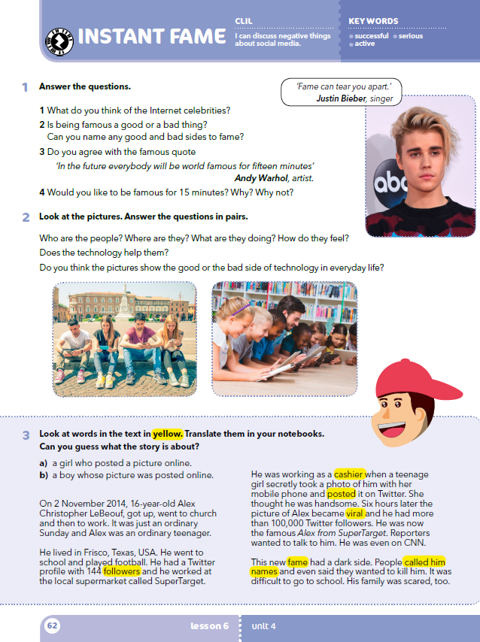
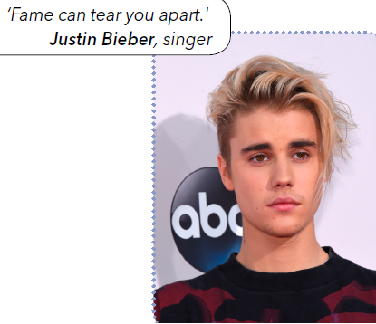
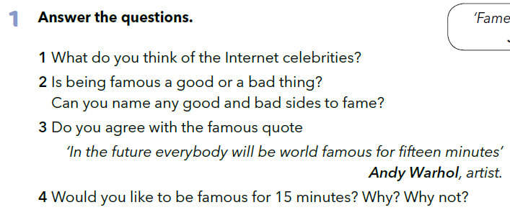
Do you know privately anyone who is famous? Who is your favourite celebrity? Would you like to become famous? Why? What are the good sides / bad sides to being famous?

Slide 3
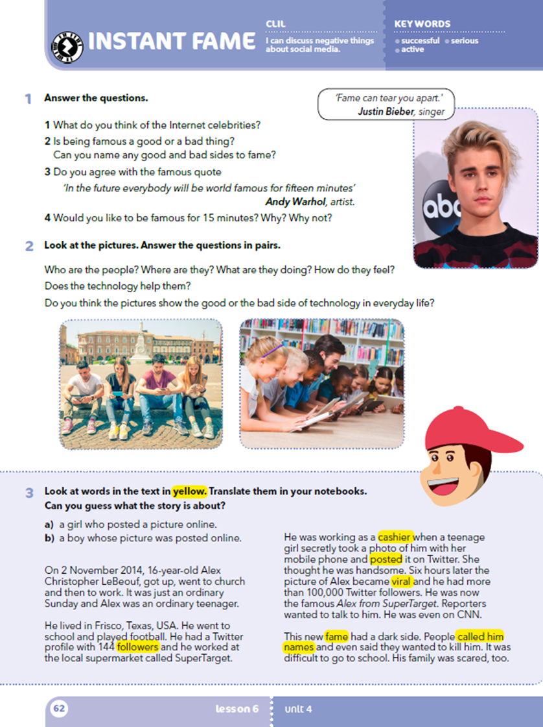
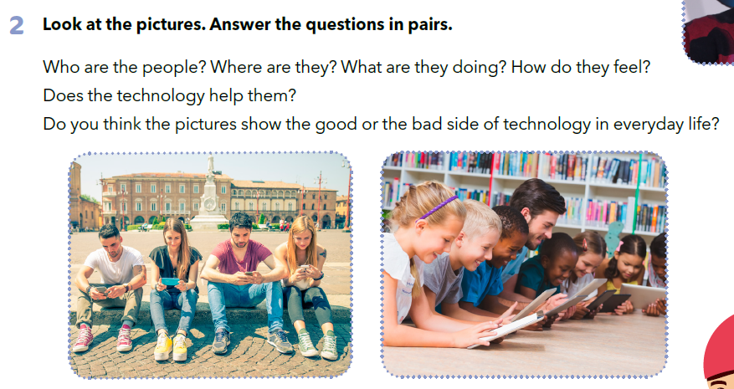

Slide 4
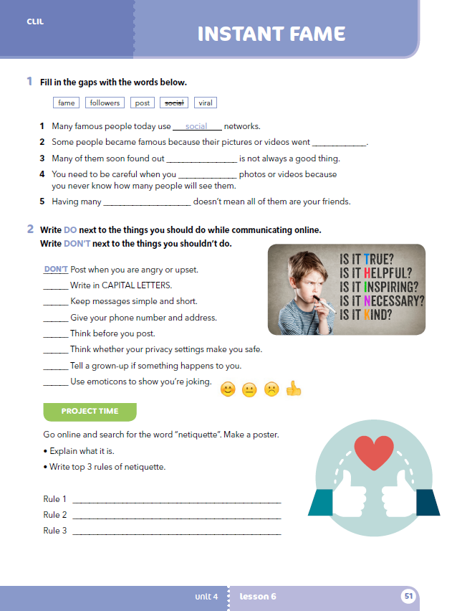
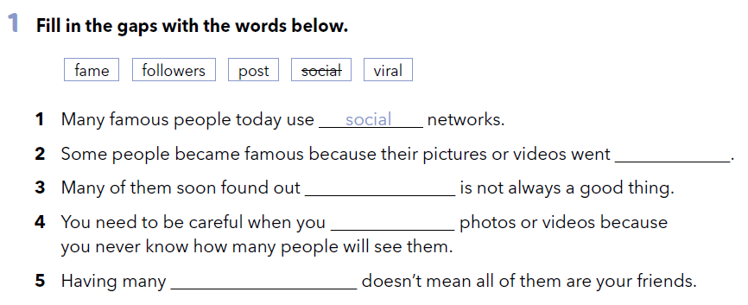
Worbook, p. 51
viral
fame
post
followers

Slide 5
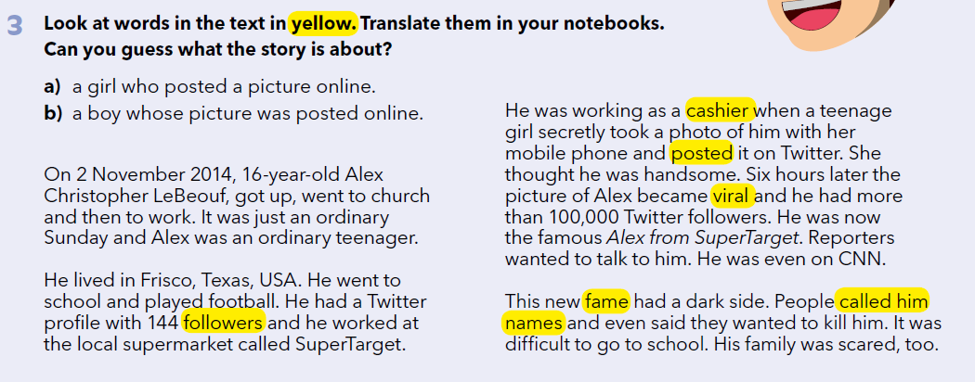

Which social media are you familiar with?
Which ones do you use? Do you often post your photos?
Who are ‘followers’?
Can you name some people who have a lot of followers?
Are all the followers and their comments kind?
Look at words in the text in yellow. Translate them in your notebooks. Can you guess what the story is about?
Check.
Practise:
https://wordwall.net/play/902/616/427

Slide 6
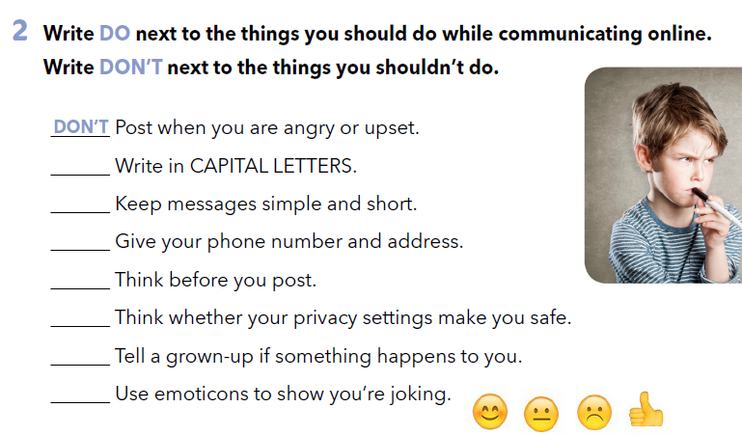
Workbook, p. 51
don’t
do
don’t
do
do
do
do

Slide 7

LEARN MORE!
https://www.e-sfera.hr/dodatni-digitalni-sadrzaji/fcd813df-121c-408f-89ba-f5502d839905/
Viral Videos

Slide 8
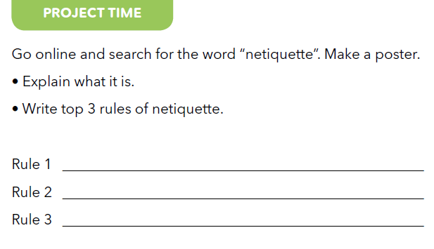
Workbook, p. 51

